Slide 1
Tesla in Indian Market : Business Case Study

Slide 2

MEET OUR TEAM
Rishabh Sengar
Syed Shoeb
Rahul Bisht
Ravi Kumar Agarwal

Slide 3
COMPANY OVERVIEW
Company Name : Tesla, Inc.
CEO : Elon Musk (since 2008)
Company Type : Electric vehicle manufacturer and clean energy company
Year Founded : 2003
Number of Employees : 99,000
Area served : North America, East Asia, Europe
Headquarters : Palo Alto, California, United States

Slide 4
About Tesla
Tesla, Inc. Is an American Multinational Automotive and Clean Energy Company. Tesla Designs and Manufactures Electric Vehicles (Electric Cars and Trucks), Battery energy storage from home to grid-scale, solar panels and solar roof tiles, and related products and services.
Tesla was incorporated in July 2003 by Martin Eberhard and Marc Tarpenning as Tesla Motors. The company's name is a tribute to inventor and electrical engineer Nikola Tesla.
Tesla began production of its first car model, the Roadster sports car, in 2009. This was followed by the Model S sedan in 2012, the Model X SUV in 2015, the Model 3 sedan in 2017, the Model Y crossover in 2020, and the Semi truck in 2022.

Slide 5
Company Size
Year | Revenue (mil. USD) | Net income (mil. USD) | Total assets (mil. USD) | Employees
Year | Revenue (mil. USD) | Net income (mil. USD) | Total assets (mil. USD) | Employees
2005 | 0 | -12 | 8
2006 | 0 | -30 | 44 | 70
2007 | 0.073 | -78 | 34 | 268
2008 | 15 | -83 | 52 | 252
2009 | 112 | -56 | 130 | 514
2010 | 117 | -154 | 386 | 899
2011 | 204 | -254 | 713 | 1,417
2012 | 413 | -396 | 1,114 | 2,914
2013 | 2,013 | -74 | 2,417 | 5,859
2014 | 3,198 | -294 | 5,831 | 10,161
2015 | 4,046 | -889 | 8,068 | 13,058
2016 | 7,000 | -675 | 22,664 | 17,782
2017 | 11,759 | -1,962 | 28,655 | 37,543
2018 | 21,461 | -976 | 29,740 | 48,817
2019 | 24,578 | -862 | 34,309 | 48,016
2020 | 31,536 | 721 | 52,148 | 70,757
2021 | 53,823 | 5,519 | 62,131 | 99,290

Slide 6
Revenue Model
Tesla's business model is based on direct sales and service, not franchised dealerships.
Tesla's business model pays particular attention to rolling out charging stations. That may be the biggest obstacle to the mass adoption of electric vehicles.
Tesla has stretched the business model to encompass energy storage systems for homes and businesses.
In 2021, Tesla made $53.8 billion. from three business segments: Sales and Services, which includes Automotive and Energy generation & storage sales, Automotive leasing, and Energy generation and storage leasing.

Slide 7
MARKET Competitors
Nissan
Toyota Motor Corporation
Ford Motors Company
BMW
Honda
Audi
General Motors
Daimler & More

Slide 8
Socioeconomic factors
Market Position
Tesla cars are one of a kind. They have popularized the notion of luxurious electric cars in the minds of people. This part of the analysis also focuses on maximizing profit for the organization studying its investor, buyers, and employees understanding the socio-cultural aspects of a place.
The environment-friendly attitude of people and renewable energy resources popularity; both work in favor of Tesla.
BYD: 640,748 and 15.4% share (vs 5.9%)
Tesla: 564,873 and 13.6% share (vs 15.2%)
SAIC (incl. SAIC-GM-Wuling): 358,040 and 8.6% share (vs 11.1%)
Volkswagen Group: 331,743 and 8.0% share (vs 13.4%)
Geely -Volvo: 231,232 and 5.6% share

Slide 9
PUBLIC RELATIONS & Media
Market Size
Brands 2022
BYD Auto 20%
Tesla 13%
Wuling 5%
Volkswagen 4%
GAC Motor 3%
Others 55%
Look at Tesla. Compared to other car companies, Tesla has a tiny ad budget. According to a report from Global Equities Research, Tesla only spends $6 per vehicle on advertising. By comparison, Toyota, spends $248 per vehicle. While luxury car manufacturers like Jaguar, spend a few thousand dollars per car on advertising.
Instead, Tesla has a public relations strategy that focuses on sharing information through Musk’s personal Twitter account, which currently stands at over 38 million followers. And by information, we mean headline-grabbing soundbites that are retweeted and shared across all platforms. Which in turn are picked up and covered in the traditional press.

Slide 10
Coming to india tesla may face the following problems
Lack of infrastructure: India's infrastructure, particularly in terms of electric vehicle (EV)charging and maintenance, may not be developed enough to support Tesla's EVs. This could cause delays in delivering vehicles to customers and increased costs for Tesla.
2. Government regulations and policies: India's regulations and policies regarding EVs and foreign companies may be a barrier for Tesla. This could include tariffs, import taxes, and regulations around manufacturing and assembling vehicles in the country
4. Consumer perception and affordability: Tesla's vehicles may be perceived as too expensive for the average Indian consumer and may not appeal to the mass market.
5. Supply chain disruptions: Tesla's supply chain may be impacted by disruptions caused by the COVID-19 pandemic, which could lead to production delays and supply shortages

Slide 11
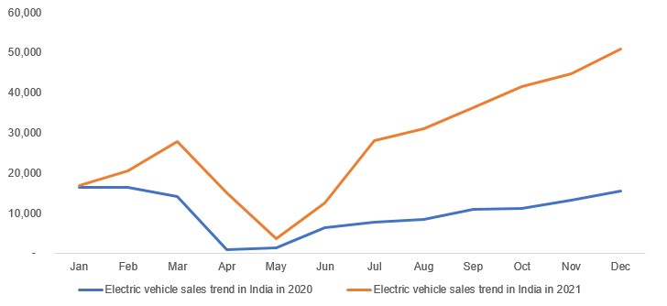
Competitors in india
EV TREND IN INIDIA
Hyundai Motor Company
Mahindra & Mahindra Ltd.
Volvo Car Corporation
Toyota Kirloskar Motor Pvt. Ltd.
Tata Motors Limited
Honda Motor Co. Ltd.
AB Volvo

Slide 12
RECOMMANDATION FOR TESLA
Follow the Govt Policies and make at least one small factory for Assembling the parts and providing the service to the Consumers and start looking into the growth. Since it will be part of the Research and Development, this strategy will not get wasted, and if not here then somewhere else can be used as a Trail.
India is a Tech Hub and also it is hungry for an economically friendly products, which can lead to success in the business

Slide 13
THANK YOU

